Slide 1
Evaluation and tuning
Mohammad ghoddosi

Slide 2
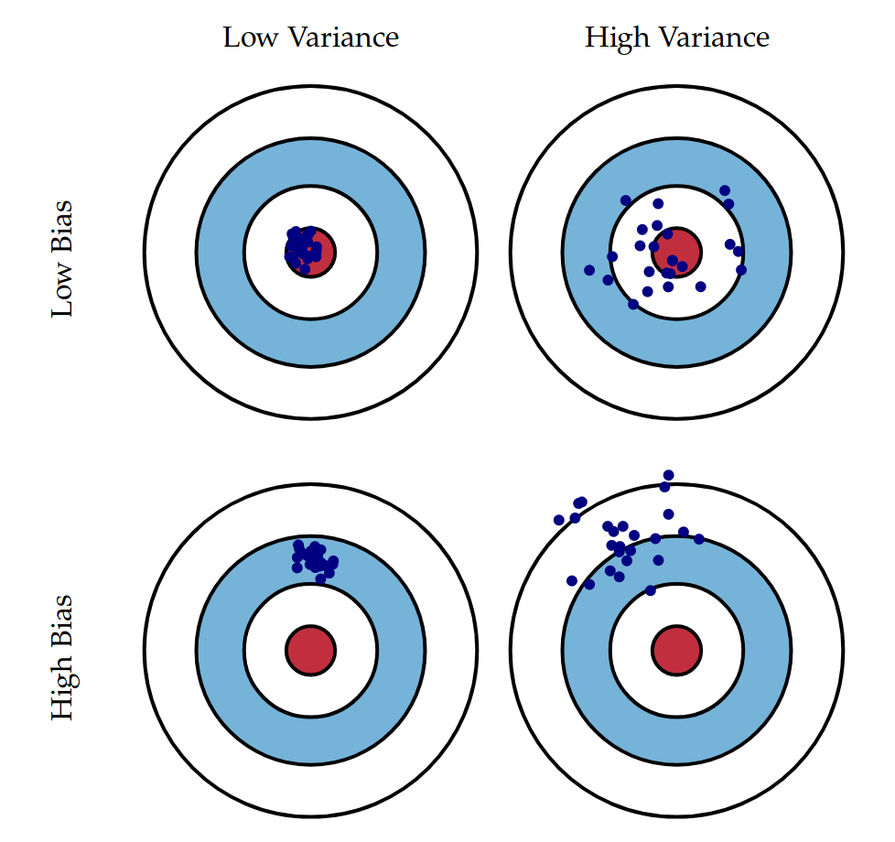
Bias and variance

Slide 3
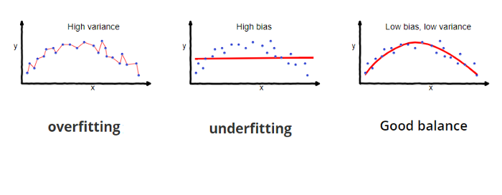
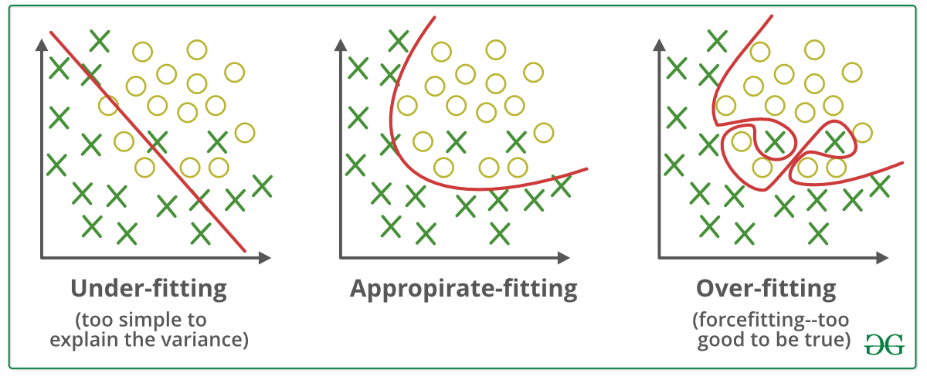
Overfitting and underfitting

Slide 4
Train-test split
Dataset
Train
Test

Slide 5
Train-test - validation split
Dataset
Test
Train
validation

Slide 6
K-fold cross validation
Dataset
Fold 1
Fold 2
Fold 3
Fold 4
Fold 5
Test

Slide 7
K-fold cross validation
Dataset
Fold 1
Fold 2
Fold 3
Fold 4
Fold 5
Test

Slide 8
K-fold cross validation
Dataset
Fold 1
Fold 2
Fold 3
Fold 4
Fold 5
Test

Slide 9
K-fold cross validation
Dataset
Fold 1
Fold 2
Fold 3
Fold 4
Fold 5
Test

Slide 10
K-fold cross validation
Dataset
Fold 1
Fold 2
Fold 3
Fold 4
Fold 5
Test

Slide 11
K-fold cross validation
Dataset
Fold 1
Fold 2
Fold 3
Fold 4
Fold 5
Test

Slide 12
Hyper parameter tuning
Grid search
Random search
Evolutionary optimization
…

Slide 13
Learning curve (old)
validation set
Loss
Training set
Training set size

Slide 14
Learning curve (new)
validation set
Loss
Training set
Iterations

Slide 15
Handling underfitting
Increase model capacity
Add polynomial features
Increase features
Get more features
Use feature extraction
Reduce regularization
Use more powerful models
…

Slide 16
Handling overfitting
Reduce model capacity
Reduce parameters
Reduce polynomial degree
Remove some features
Apply regularization
Increase data size
Early stopping
…

Slide 17
Performance measures
Accuracy
Confusion matrix
Precision
Recall
F1-score
ROC-AUC

Slide 18
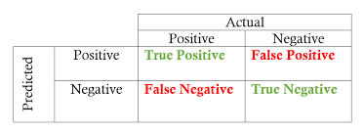
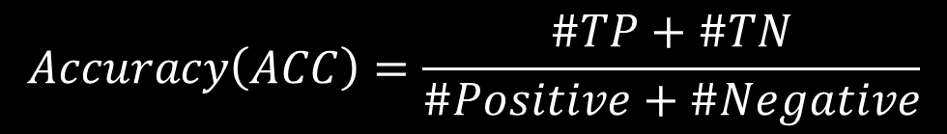
Performance measures (acc)
$$Accuracy\left(ACC\right)=\frac{\#TP+\#TN}{\#Positive+\#Negative}$$

Slide 19
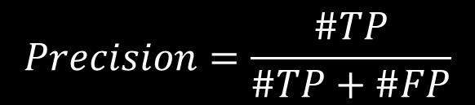
Performance measures (precision)
$$Precision=\frac{\#TP}{\#TP+\#FP}$$

Slide 20
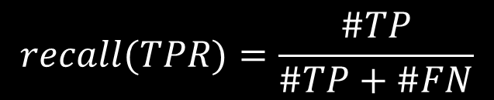
Performance measures (recall)
$$recall(TPR)=\frac{\#TP}{\#TP+\#FN}$$

Slide 21
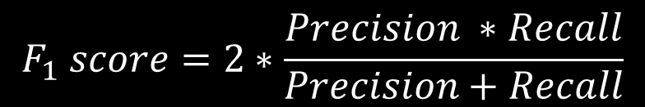
Performance measures (F1-score)
$$F_{1} score=2∗\frac{Precision ∗Recall}{Precision+Recall}$$

Slide 22
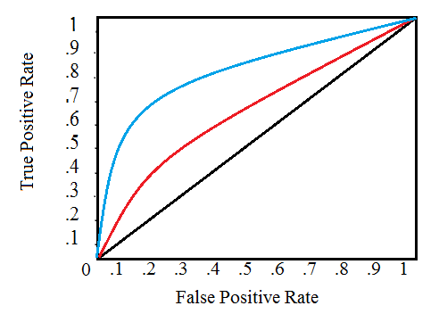
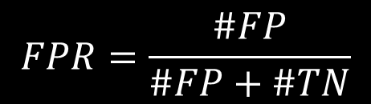

Receiver operating characteristic (Roc) curve
$$TPR=\frac{\#TP}{\#TP+\#FN}$$
$$FPR=\frac{\#FP}{\#FP+\#TN}$$

Slide 23
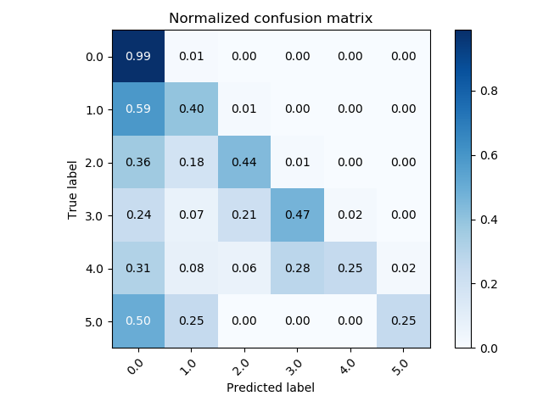
Confusion matrix

Slide 24
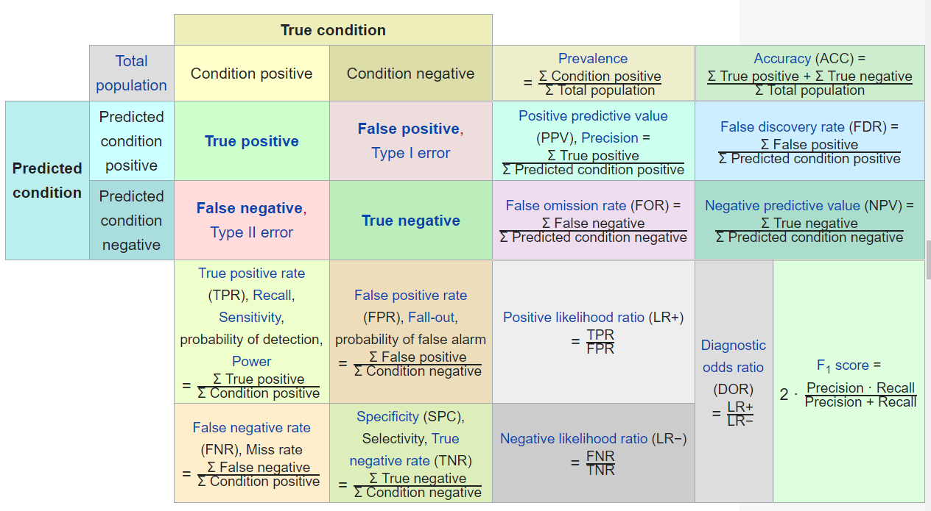
Performance measures

Slide 25
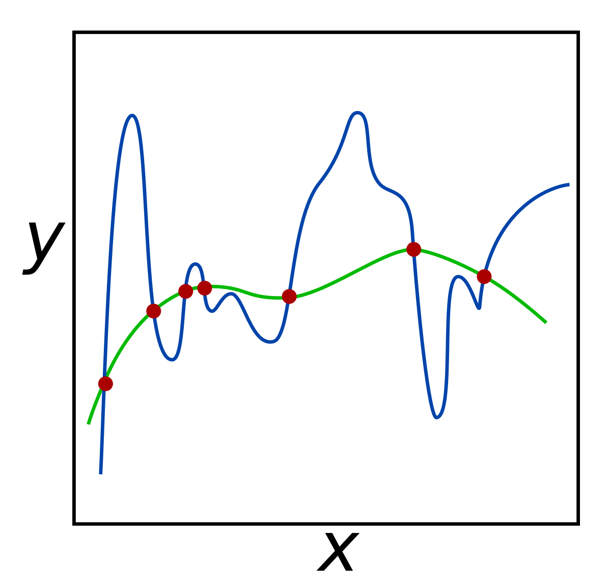
Regularization

Slide 26
Regularizations
What causes overfitting:
Large weights (large derivatives)
Many features
Model trained too much
Powerful model
Regularizations are techniques used to avoid overfitting.

Slide 27
Regularizations
Large weights (large derivatives)
L2 regularization
Many features
L1 regularization
Model trained too much
Early stopping
Powerful model
dropout

Slide 28

L2 regularization
$$\hat{J}=J+α\sum_{i=1}^{M}{w_{i}^{2}}$$
$$=J+λ\sum_{i=1}^{M}{w_{i}^{2}}$$
$$=J+\frac{1}{C}\sum_{i=1}^{M}{w_{i}^{2}}$$
Large weights
So force model to chose small weights
ridge regression

Slide 29

L1 regularization
Many features
So force model to chose some features
Lasso regression
$$\hat{J}=J+α\sum_{i=1}^{M}{{|w}_{i}|}$$

Slide 30
Early stopping
Stop model from training when validation loss is going upward
validation set
Loss
Training set
Iterations

